Slide 1

Global Academy of Technology
Dr. Remya P. N.
Associate Professor
Department of Science & Humanities

Slide 2

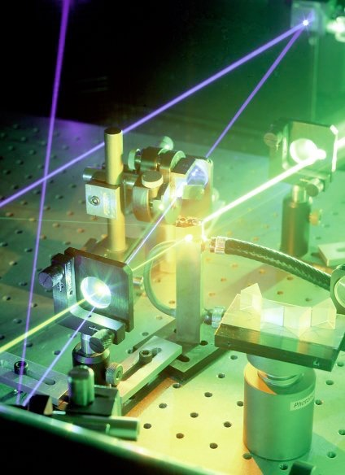
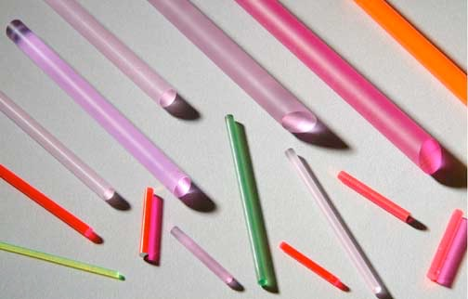
MODULE 1:
Light Amplification by Stimulated Emission of Radiation

Slide 3
MODULE 1:
LASERs & Optical fibers
LASERs:
Interaction of radiation with matter,
Einstein’s coefficients
Requisites and condition for laser action
He-Ne LASER
Application of lasers in measurement of pollutants in the atmosphere
Numerical problems.

Slide 4


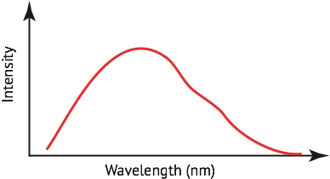
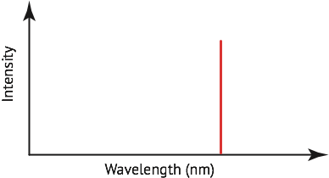
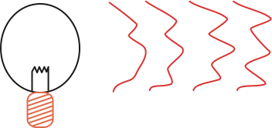
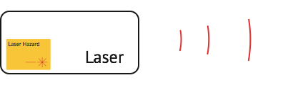
MODULE 1:
What makes lasers special?
They produce a
directional beam.
They have a narrow spectrum (or bandwidth).
They are coherent.

Slide 5
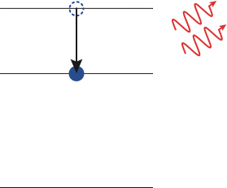
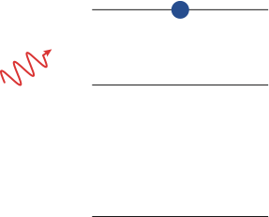
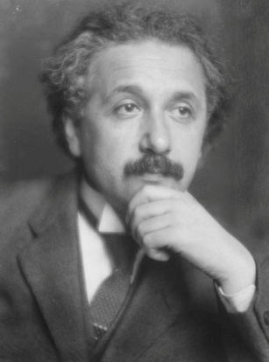
MODULE 3:
Einstein identified 3 ways in which atoms exchange energy with a radiation field
Absorption
Spontaneous emission
Stimulated emission
Rate of absorption/stimulated emission dependent on no of photons & number of atoms in lower/upper state.
photon needs to have correct energy
the number of photons can be amplified
stimulated emission
Albert Einstein

Slide 6
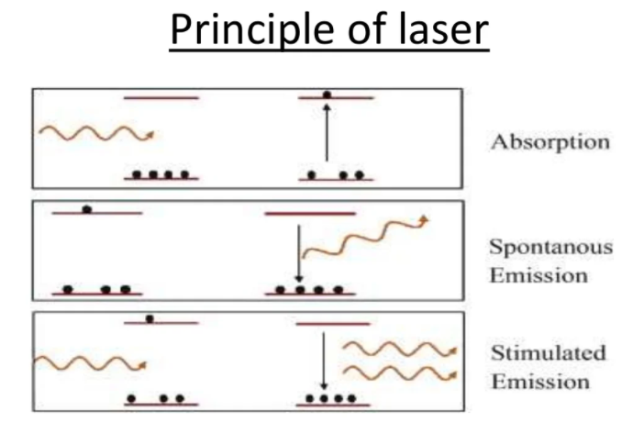
MODULE 3:
Interaction of radiation with matter
There are three possible ways through which interaction of radiation & matter can take place.

Slide 7
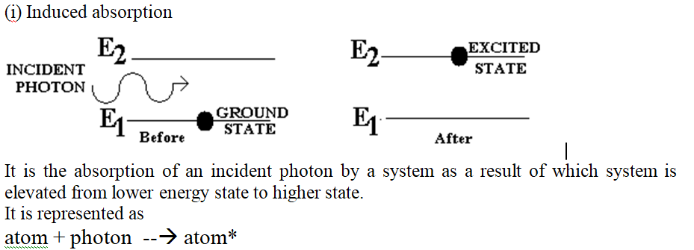
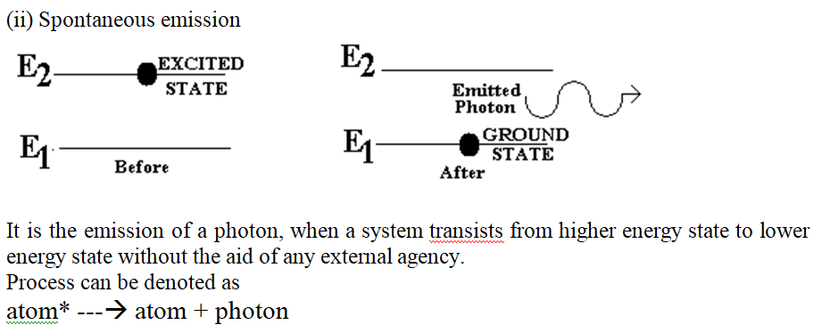
MODULE 1:

Slide 8
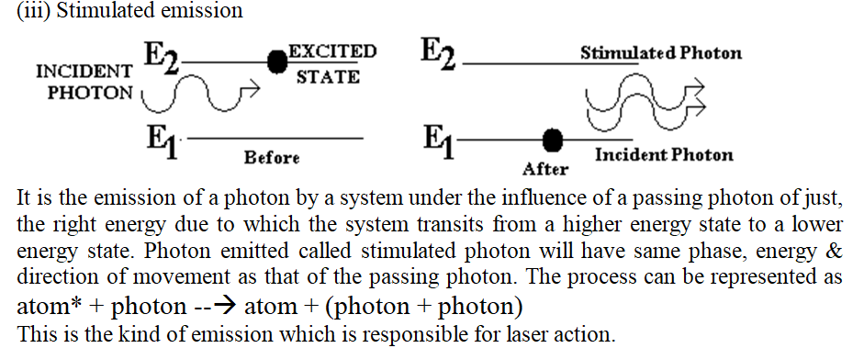
MODULE 1:

Slide 9
MODULE 1:
Energy density in terms of Einstien's A & B coefficients
Consider two energy states E₁ and E₂ of a system of atoms.
Let there be N₁ atoms with energy E₁, and N₂ atoms with energy E₂ per unit volume of the system.
N₁ and N₂ are called the number density of atoms in the states 1 and 2 respectively.
Let radiations with a spectrum of frequencies be incident upon the system.
Let U_{ν}dν be the energy incident per unit volume of the system. considering only those radiations whose frequencies lie in the range ν and ν+dν. Then, U_{ν} represents the energy density of frequency ν.

Slide 10
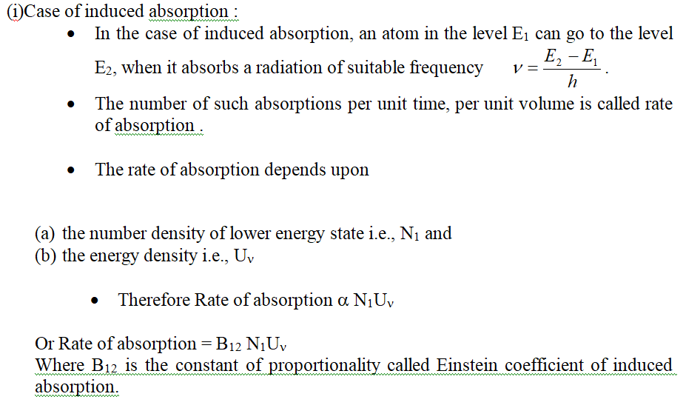
MODULE 1:

Slide 11
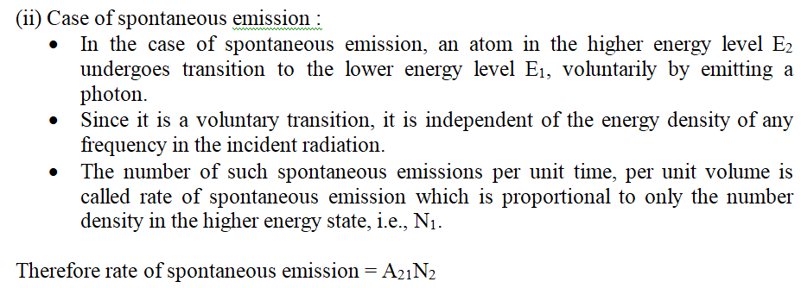
MODULE 1:
Where A₂₁ is the constant of proportionality called the Einstein’s coefficient of spontaneous emission.

Slide 12
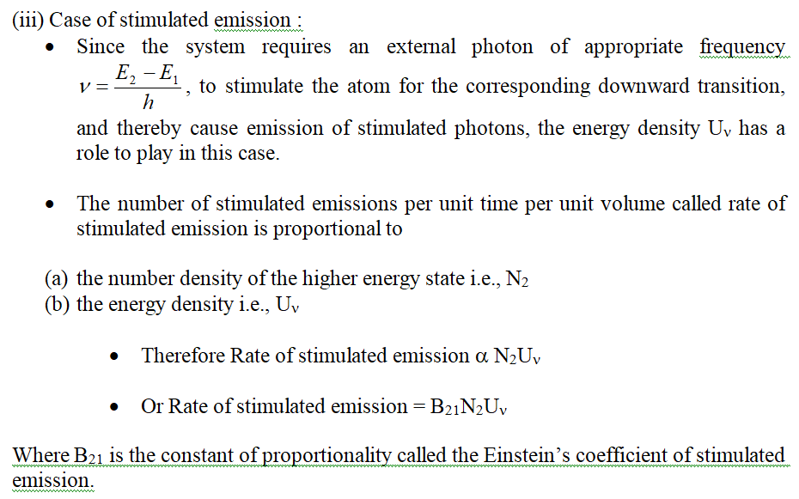
MODULE 1:

Slide 13
MODULE 1:
Let the system be in thermal equilibrium, i.e., the total energy of the system remains unchanged in spite of the interaction that is taking place between itself and the incident radiation.
Under such a condition, the number of photons absorbed by the system per second must be equal to the number of photons it emits per second by both the stimulated and the spontaneous emission processes.
Therefore at thermal equilibrium,
Rate of absorption = Rate of spontaneous emission + Rate of stimulated emission
Therefore from equations, we have
B₁₂U_{ν}N₁ = A₂₁N₂ + B₂₁U_{ν}N₂
_{Or Uν} (B₁₂N₁ - B₂₁N₂) = _{A21}N₂

Slide 14
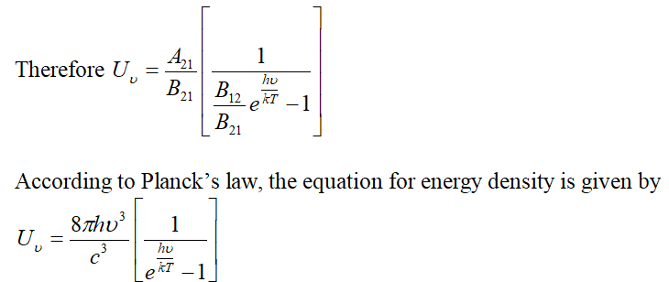
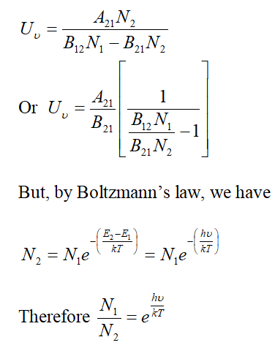
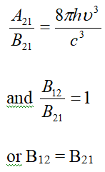
MODULE 1:
Comparing above two equations term by term on the basis of positional identity

Slide 15
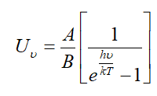
MODULE 1:
The probability of induced absorption is equal to the probability of stimulated emission.
Because of the above identity, the subscripts could be dropped, and A₂₁ and B₂₁ can be represented as A and B.
Therefore at thermal equilibrium, the equation for energy density is

Slide 16
MODULE 1:
Requisites of a laser system
The requisites of a laser system are
An excitation source for pumping action
An active medium which supports population inversion
A laser cavity
The excitation source provides the appropriate amount of energy for pumping the atoms to higher energy levels.
The energy input may be in the form of light energy.
This kind of pumping is called optical pumping and is made use of in the construction of Ruby laser.
The pumping may be achieved by electrical energy input in which case it is electrical pumping.
In He-Ne laser, the pumping is achieved by electrical discharge.
A part of the input energy is absorbed by the active medium in which population inversion occurs at a certain stage. After this stage the medium attains capability to issue laser light.
The laser cavity provides the feedback necessary to tap certain permissible part of laser energy from the active medium.

Slide 17
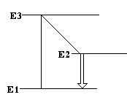
MODULE 1:
Condition for laser action
The conditions for continuous laser action are the population inversion and metastable states.
By providing energy, if an atom is made to go to one of its excited states, it stays there over a brief interval of time not exceeding 10⁻⁸ s, & then returns to one of the lower energy states.
In case the state to which the atom is excited is a metastable state, then the atom stay in that state for an unusually long time, which is of the order of 10⁻³ to 10⁻² s.
This property helps in achieving the population inversion in the following way.

Slide 18
MODULE 1:
Consider three energy levels E₁, E₂ & E₃ where E₃ > E₂ > E₁.
Let E₂ be a metastable state of the system.
Let the atoms be excited from E₁ to E₃ by the supply of appropriate energy.
From E₃ state, the atoms undergo spontaneous downward transitions to E₁ & E₂ states rapidly.
But since E₂ is a metastable state, those atoms which get into that state stay over a long duration, because of which the population of E₂ state increases steadily.
Under these conditions, a stage will be reached wherein the population of E₂ state overtakes that of E₁, which is known population inversion.
Once population of E₂ exceeds that of E₁, stimulated emissions outnumber spontaneous emissions, & soon stimulation photons, all identical in respect of phase, wavelength & direction grow to a very large number which build up laser light.

Slide 19
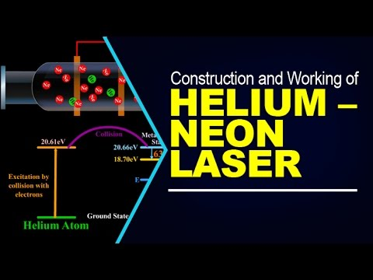
MODULE 1:
He-Ne LASER
He-Ne laser, is a type of gas laser whose gain medium consists of a mixture of 10:1 ratio of helium and neon at a total pressure of about 1 torr inside of a small electrical discharge. The best-known and most widely used He-Ne laser operates at a wavelength of 632.8 nm, in the red part of the visible spectrum.

Slide 20
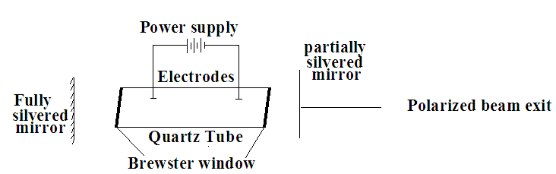
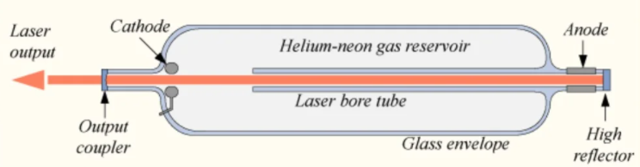
MODULE 1:
Construction & working of He-Ne laser
It consists of a quartz tube filled with a mixture of helium & neon gas
Flat quartz plates which function as Brewster's window are sealed to the tube at both of its ends.
Two optically plane mirrors are fixed on either side of the tube. One is fully silvered & other is partially silvered.
Notes:
Brewsters angle for 0% transmission loss

Slide 21
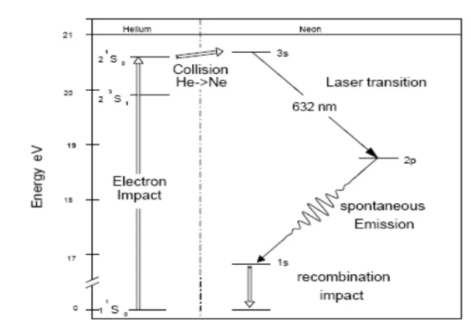
MODULE 1:

Slide 22
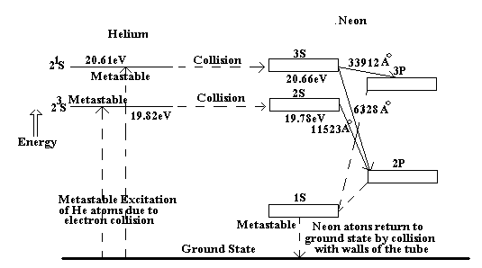
MODULE 1:
Working:
When a voltage of 1000 V is applied across the two electrodes, a glow discharge of gas is initiated.
During discharge, many electrons are rendered free from the gas atoms.
Electrons accelerate towards positive electrode during which it collides with the atoms in their path
Collisions with helium atoms occur in large number since helium is the majority gas present

Slide 23
MODULE 1:
Working:
This can be represented as e₁ + He = e₂ + He* ,here e₁ & e₂ are the energy values of electrons before & after collision. He & He* are energy values of helium atom in ground & concerned metastable state respectively
There is a pumping of helium atoms
When helium atom in the metastable state collides with a neon atom in the ground state, because of matching of energy levels, neon atoms get elevated to 3s & 2s level, while helium atoms return to ground state
It can be represented as He* + Ne = He + Ne*

Slide 24
MODULE 1:
Working:
Population of 2s & 3s levels of neon increases rapidly which leads to population inversion
Once population inversion is established between the higher states (3s & 2s) w.r.t. lower ones (3p & 2p), three main transitions become available as shown in the diagram
Following three transitions, the atoms from 3p & 2p levels undergo spontaneous transitions to 1s level
But 1s level is the metastable state for neon, because of which its population increases rapidly.
This problem is counteracted by the fact that though the atoms in the metastable state tend to stay there for long, they come down immediately to lower state whenever they collide with the walls of the container
Starting from the stage of excitation of helium atoms to the stage of neon atoms coming to ground state, the cycle works
Since the discharge in the tube is maintained continuously, the cycle of events also take place continuously & the emission of laser radiations is also continuous.

Slide 25
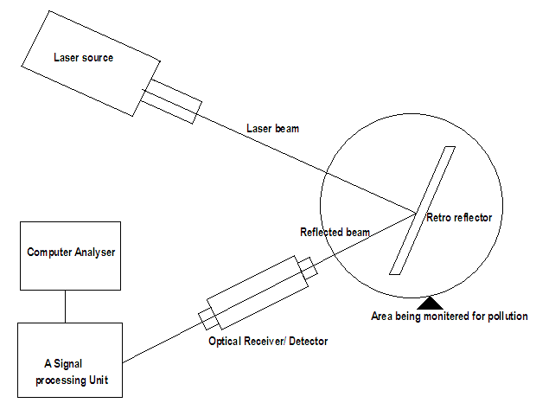
MODULE 1:
Measurement of pollutants in atmosphere using laser
The pollutants in the atmosphere include sulphur dioxide, nitrous oxide, carbon monoxide, etc.
Atmospheric optics uses lasers for remote probing of the atmosphere, including the measurement of traces of pollutant gases, water vapour concentration, sometimes at range of 8-15 km.
The system consists of a laser source, a transreceiver optical system, a signal processing electronic unit, and a retroreflector source.

Slide 26
MODULE 1:
Measurement of pollutants in atmosphere using laser
The principle involves projecting a laser beams through the atmosphere, the area where the pollutants are to be measured and the measurement is based on the spectral absorption of the laser beam.
Basically, different gases absorb laser energy at different wavelengths, and the amount of absorption by each wavelength indicates the amount of pollutant in the atmosphere.
It uses a tunable carbon-dioxide laser source, i.e., the laser frequencies can be varied which are characteristics of the different pollutant through the atmosphere to a retroreflector located at far off distance (10-15 km).
The reflected laser beam is then received by an optical system and detector.
The laser beam undergoes attenuation due to spectral absorption by the pollutants at particular frequencies, in the atmosphere.
The attenuated beam received at the detector and the beam energy is integrated and compared with the reference laser energy
An error signal is generated by differences in the absorbed wavelengths, and the error signal is analysed and converted into a direct readout by the computer.
The reading indicates the concentration of the pollutant in the beam path.
Such systems are capable of detecting concentrations down to about 15 ppb (parts per billion) of different gas molecules, and generally used for pollution monitoring in the urban and industrial areas.

Slide 27
https://www.youtube.com/watch?v=UheTlVwukWg
https://www.youtube.com/watch?v=PXOyCj3hqWg
https://www.youtube.com/watch?v=X5_BP0odPTg
https://www.youtube.com/watch?v=RyY4PEpV2RQ

